Slide 1
Four Things to Remember
Four Things to Remember
TRUST in God’s plan for your life
“The Lord has amazing plans for my life.” 1Cor 2:9
SURRENDER to His will for you
“The Lord is doing something new in my life.” Isa 43:19
BELIEVE in Jesus and His true presence in the Eucharist
“The Holy Spirit guides me to all truth.” John 16
RECEIVE all He has to gift freely to you
“The Lord is my shepherd and I lack nothing.” PS 23:1

Slide 2
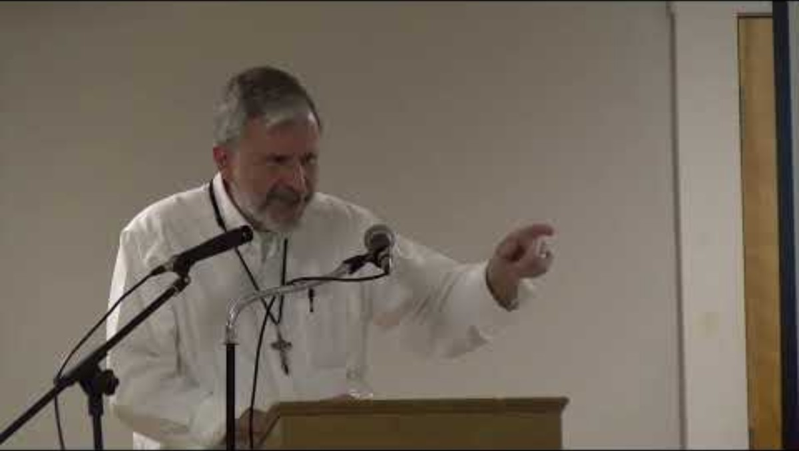
Review of Session 3
https://youtu.be/ULhjT9zZVzQ?si=msZzhz4Bp-Qjmlh3

Slide 3

Life in the Spirit
Seminar
Session 4 – The Healing Touch
of God

Slide 4
Holy Spirit
(Ostinato Refrain)
Holy Spirit come into our lives
Holy Spirit make us truly wise
Verses
1- Give us a spirit of wisdom
An understanding heart
Give us a spirit of knowledge
And lead us to the truth
Refrain
Refrain
2- Give us a spirit of courage
And judgement that is wise
Give us a spirit of reverence
Of wonder and of awe
Refrain
3- Spirit of love and compassion
Give hope to all the poor
Spirit of justice and mercy
Come open every door
Refrain

Slide 5
Refrain
Holy Spirit come into our lives
Holy Spirit make us truly wise
4-Spirit of all consolation
O lift our hearts this day
Spirit of all understanding
O help us know your way
Refrain
5- Spirit of light and of wisdom
O lift us from our sorrow
Spirit of peace and forgiveness
O help us face tomorrow
Refrain
6- Spirit of strength and of healing
Bend stubborn heart and will
Spirit of trust and of caring
O melt us, warm our chill
Refrain

Slide 6
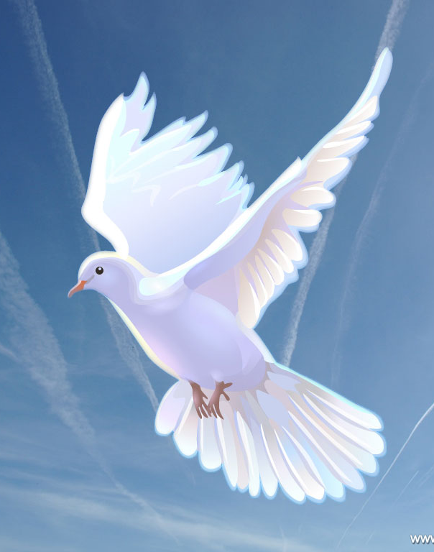
"Come, Holy Spirit, fill the hearts of your faithful and kindle in them the fire of your love. V. Send forth your Spirit and they shall be created. R. And You shall renew the face of the earth. Let us pray. O God, who by the light of the Holy Spirit, did instruct the hearts of the faithful, grant that by the same Holy Spirit we may be truly wise and ever enjoy His consolations. Through Christ Our Lord. Amen."
This Photo by Unknown Author is licensed under CC BY

Slide 7
God is the Potter, We are the Clay
Scripture frequently uses the image of a pot to describe our relationship with God.
Scripture also speaks of how we have a tendency to rebel against God’s will for our lives, and in doing so, destroy his plan for our lives, as well as our effectiveness in his service.
Our lives, because of our hurt , rebellion and sin, are like shattered pots – created to hold the beauty of Go’s love, but shattered and unable to do so.
The thirty pieces of silver Judas was given and then threw in to the temple was used to be that Potter’s Field where all of the broken pots were thrown.
The Potter’s Field is a symbol of our lives, of the world.
The Potter’s Field was bought with the price paid for Jesus' life. Our lives are no longer useless but can be healed and restored.

Slide 8
Obstacles to God’s Healing Love
Jesus saves us from our sins and the effects of our sins and the sins of others.
One obstacle is failing to take responsibility for our sinful actions, wrong attitudes and reactions to hurts.
When we begin to take responsibility for our wrongful responses and attitudes, we need to accept forgiveness from God.
Many have difficulty forgiving ourselves for our past sins and failings.
Our inability to forgive others hinders the power of God’s love in our lives.
Involvement in occult practices can be a spiritual obstacle to God’s power in our lives.

Slide 9
Opening to God’s Healing Love
Take a moment to think about the obstacles to God’s healing love might be:
Are there areas of sin which we have not acknowledged?
Have we failed to accept God’s forgiveness?
Do we need to forgive ourselves?
Are there other people we need to forgive?
Do we need to renounce occult practices?

Slide 10
Change My Heart Oh God
Change my heart Oh God, make it ever true.
Change my heart Oh God, may I be like You.
Change my heart Oh God, make it ever true.
Change my heart Oh God, may I be like You.
You are the potter, I am the clay,
Mold me and make me, this is what I pray.
Change my heart Oh God, make it ever true.
Change my heart Oh God, may I be like You.
Jesus, O Jesus
Come and fill your lambs
Jesus, O Jesus
Come and fill your lambs
Change my heart Oh God, make it ever true.
Change my heart Oh God, may I be like You.

Slide 11
Psalm 139 (V. 1-6, 12-15)
Lord, you have probed me and you know me;
You know when I sit and when I stand;
You understand my thoughts from afar….
With all my ways you are familiar.
Even before a word is on my tongue, behold
O Lord, you know the whole of it.
Behind me and before me, you hem me in
And rest your hand upon me.
Such knowledge is too wonderful for me,
Too lofty for me to attain
For you, darkness itself is not dark
And night shines as the day;
Darkness and light are the same.
Truly you have formed my inmost being;
You knit me in my mother’s womb …
My soul also, you knew full well …
Your eyes hav eseen my actions,
In your book they are all written.

Slide 12
Discussion Questions
What mental picture do you have of the disciples on Pentecost?
In what ways might it be difficult to yield to the working of the Holy Spirit?
What do you expect to happen when we pray for New Life in the Spirit with everyone on the evening of Pentecost 2025, June 8th.
What gifts do you wish to receive in more power on Pentecost?
What gifts do you wish to understand and use in your life?
What importance do repentance, conversion or reconciliation have in your family today? What importance did they have to your family when you were a child?
Do you expect this Pentecost experience to be different from your Confirmation?
Scripture
2 Cor.4:7 2 Timothy 2:20 Romans 9:20-21 Matt. 37:3-10
1 Peter 2:24 Jn. 10:10

Slide 13
Christ Be Our Light
Longing for peace, our world is troubled
Longing for hope, many despair
Your word alone, has pow’r to save us
Make us your living voice
refrain
Longing for food, many are hungry
Longing for water, many still thirst
Make us your bread, broken for others
Shared until all are fed (refrain)
Longing for light, we wait in darkness
Longing for truth, we turn to You
Make us Your own, Your holy people
Light for the world to see
refrain
Christ, be our light
Shine in our hearts
Shine through the darkness
Christ, be our light
Shine in Your church gathered today

Slide 14
Longing for shelter, many are homeless
Longing for warmth, many are cold
Make us Your building, sheltering others
Walls made of living stone
refrain
Christ, be our light
Shine in our hearts
Shine through the darkness
Christ, be our light
Shine in Your church gathered today
Many the gifts, many the people
Many the hearts that yearn to belong
Let us be servants to one another
Making Your kingdom come
Refrain

